Slide 1
IIME
By Group 3
Shubham Siddharth Vasav
Shreyash Likhit Romil Aryan

Slide 2
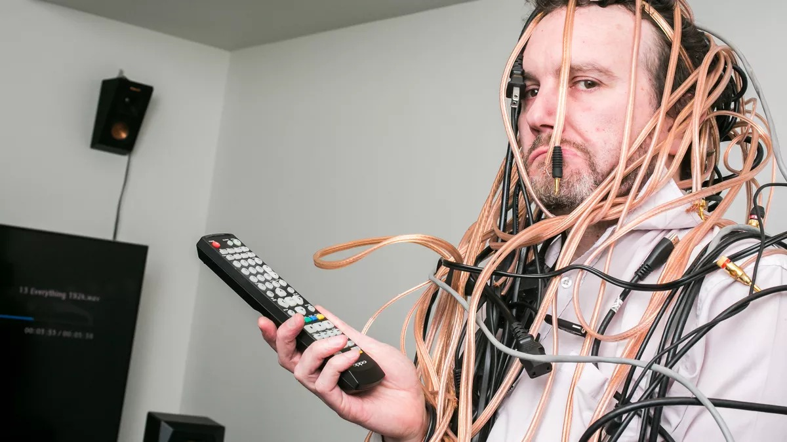

Slide 3
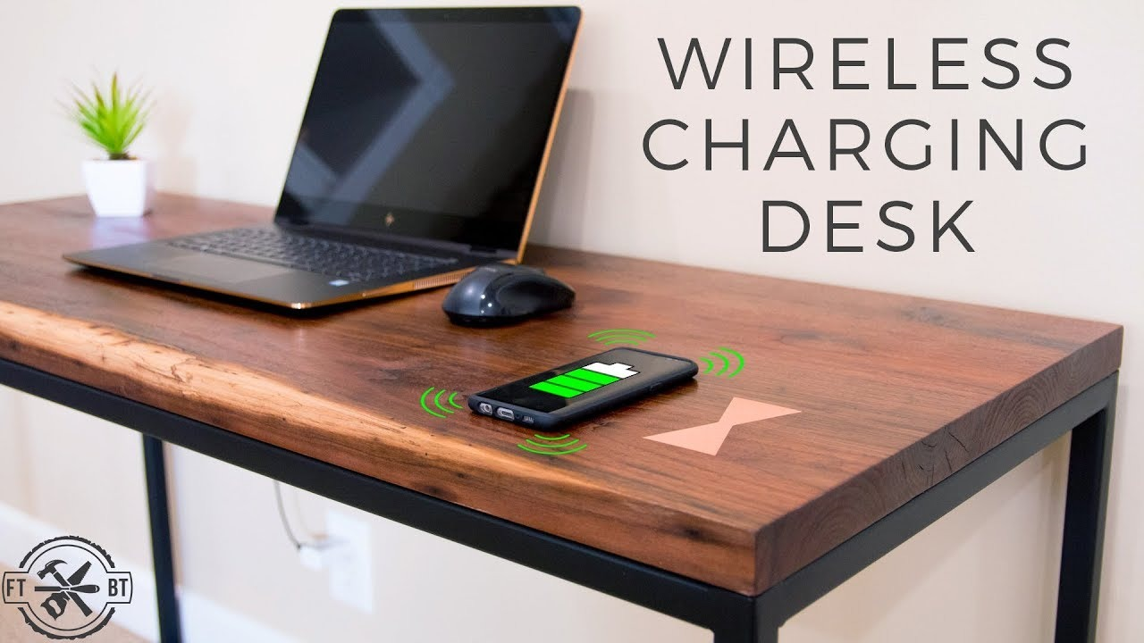

Slide 4
1. Is the idea for a new venture clear?
It is somewhat clear.
2. Is it Technology Push or Market Pull?
Technology Push.
3. Why is it interesting ? Who are the Potential customer and how is it better?
Devices can be charged wirelessly.
Wires won’t get tangled
Multiple devices can be charged
Beneficial when no charging points are nearby
Can be converted to a standing desk
Comparatively environment friendly
Potential customers are students and office employees

Slide 5
4. What hypothesis need to be true for this venture ?
Latest version of Devices having wireless charging capacity
5. When would you walk away from this effort ?
1) No profit.
2) Low interest from customer.
3)Common Idea.
4)Losses are getting greater.
6. Describe a scenario where this would be very exciting to you ?
Replacement of Desk
No wear and tear of wires

Slide 6
7. What type of team do you need ?
Hardworking
Flexible
Forward looking
Clear communication
Shared vision
Skills

